Slide 1
AI@Penn – Session 1

Slide 2
Introduction
Purpose: equip students with ability to harness AI technology, and apply it to real-world scenarios to improve, progress or better their lives or the lives of others
Approach: learn how an algorithm works, and apply it to real life situation.

Slide 3
Overview of next few weeks
Session 1: SVMs + K-Nearest Neighbours
Session 2: Logistic Regression
Intersperse with guest lectures, industry scopes, practical project lessons (e.g. OpenCV, iPhone applications, recommender systems).

Slide 4
Today’s plan
Learn about the core, underlying problem of Machine Learning
Set up programming environment - Google Cloud
Program SVM + KNN algorithms
Gain intuitive insight to algorithm

Slide 5
Machine Learning & Artificial Intelligence
Machine Learning uses statistical techniques to give computer systems the ability to "learn" (i.e., progressively improve performance on a specific task) with data, without being explicitly programmed.
Artificial Intelligence is the theory and development of computer systems able to perform tasks normally requiring human intelligence, such as visual perception, speech recognition, decision-making, and translation between languages.
ML ⊆ AI
Why now? → more data, greater CPU power, better algorithms
Subfields + Applications: Computer Vision (medical image diagnosis), Natural Language Processing (chatbots), Boltzmann Machines (recommender systems), GANs (image/video generation)

Slide 6
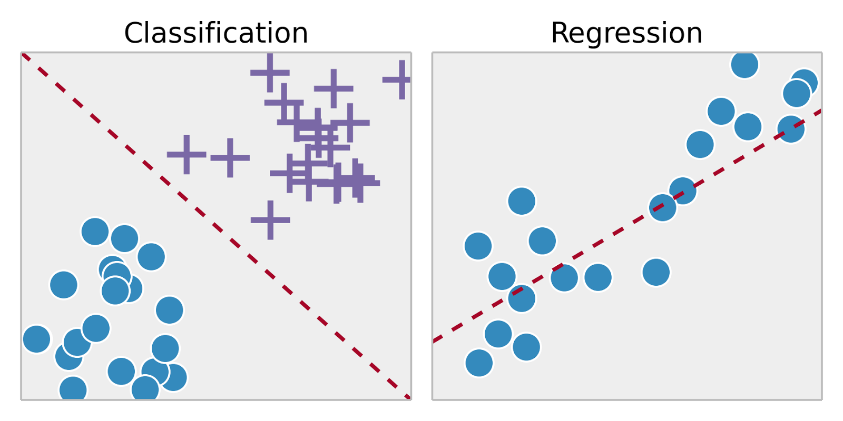
Classification vs Regression Tasks
Supervised: labelled data (eg. house prices), Unsupervised: unlabelled data (eg. bank customer data)
Classification: predicting discrete outcome (eg. handwritten digit), Regression: predicting continuous outcome (eg. house prices)
Classification requires distinct sets, and each piece of training data must belong to one

Slide 7
Process of Supervised Machine Learning
Compile/find dataset → example social media advertisement success dataset (instances, features, output value, predicted value)
Split dataset into train and test
Create algorithm framework
Feed data from dataset to algorithm using training data (training phase)
Evaluate performance of algorithm using test data (testing phase)

Slide 8
Programming Environment Setup
Google Collab: https://colab.research.google.com/
New Python 3 notebook
Allows for note-taking on the document
Efficient running of programs
Inbuilt libraries

Slide 9
Social Media Advertisement Prediction Algorithm
Import libraries
Read data
Separate into features and output values
Train-test split
Feed data into algorithm to train
Test performance

Slide 10
K-Nearest Neighbours
Choose k number of neighbours (usually around 1 per 100 data points, or just 5)
Plot new test data point on graph that has all training points
Take the k nearest neighbours according to distance metric (eg. Euclidean, Manhattan)
Among the k neighbours, count the number of data points in each category
Assign new data point to category with most neighbours

Slide 11
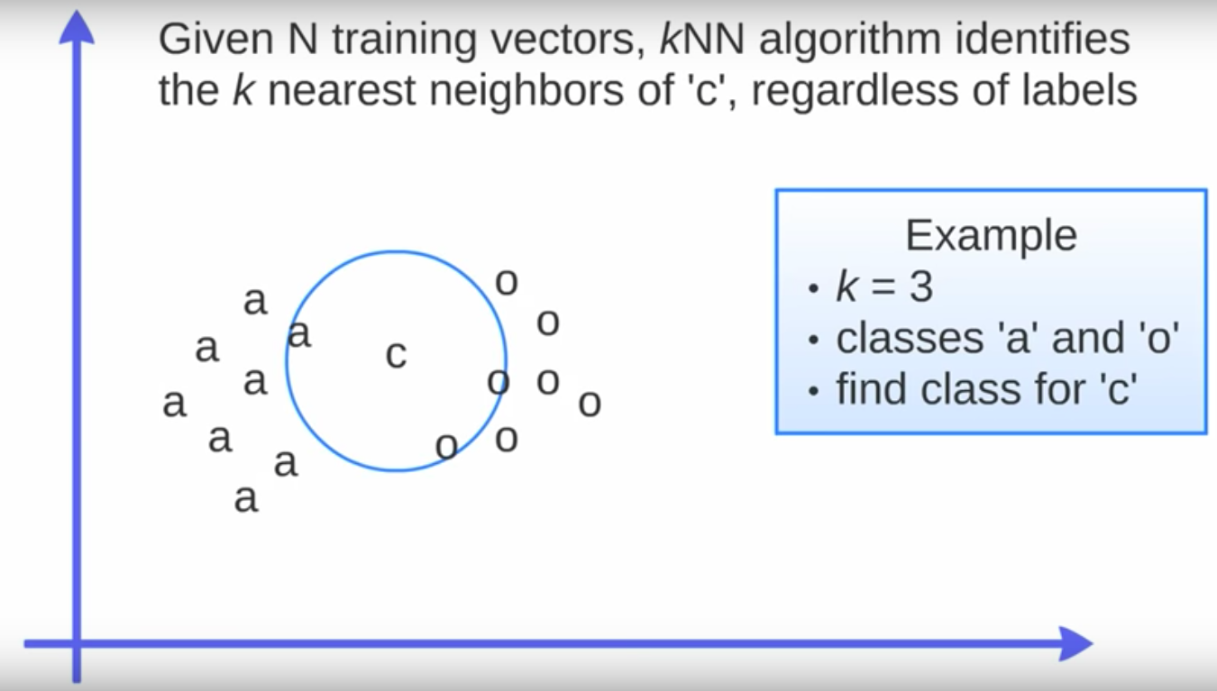
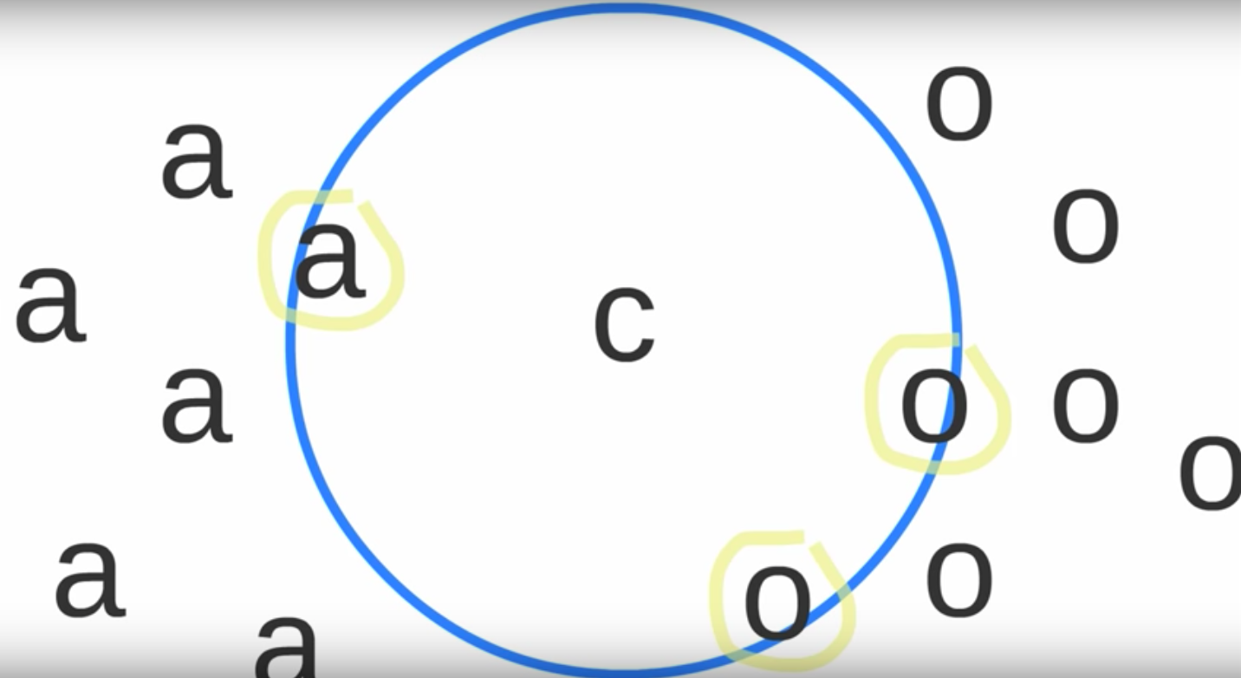
KNN Visualization

Slide 12
Support Vector Machines
Find the dividing hyperplane that splits the classes with the maximum margin.
Maximum margin is measured by the distance between the two ‘closest’ points from each class, which are known as the support vectors.
Hyperplane for each support vector constructed using parallel lines to the dividing hyperplane, that pass through each support vector.
Find distance between support vector hyperplanes → subtract y-intercept.
Minimizing this distance involves optimization, which is solved by the Karush-Kuhn-Tucker (KKT) conditions, using Lagrange multipliers.
If all points cannot be classified by a dividing hyperplane (i.e. the support vectors fall on the same side), we can penalize this differently (use diagram to demonstrate)

Slide 13
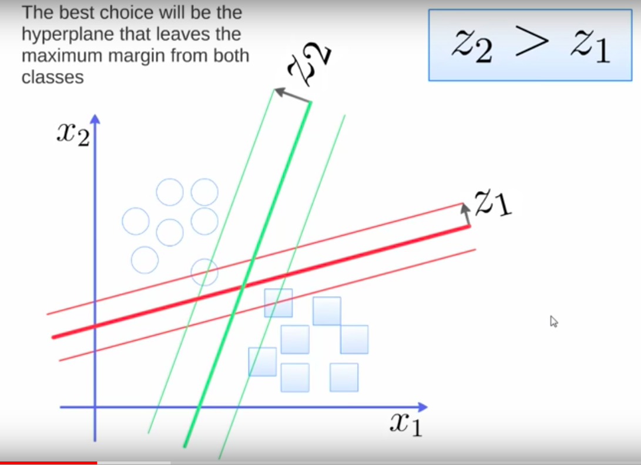
SVM Visualization

